Slide 1
Software Construction & development
Fall - 2025
Week-1
Introduction
Instructor: Mr. Sharif Hussain
Office: C-Block 5th Floor

Slide 2
Contents
Introduction
What is Software Construction & development
Importance of Software Construction & development
Key points of Software Construction & development
SWEBOK Guide (2004 Edition)
  Fundamentals of Software Construction development
  Software Construction & development Management

Slide 3
Rules
Notebook/Register: Maintain a notebook or register for class notes.
Class Participation: Active participation is encouraged.
Cell Phones: Keep them on silent or turn them off.
Attendance: A minimum of 75% attendance is required (no exceptions).
Punctuality: Arrive on time for class.
Clarifications: If you do not understand a point, ask me to explain or visit during office hours.
Classroom Conduct: No disturbances or misconduct will be tolerated.
Remember: Your first priority must be your studies.

Slide 4
Course Objectives
Understand software construction within SDLC.
Implement solutions using Java.
Design and model with UML.
Apply testing using JUnit, TestNG, Mockito, Selenium.
Use Maven/Gradle for builds and dependency management.
Follow industry standards and SWEBOK guidelines.

Slide 5
Course Assessment/Grading
Component | Numbers | Weightage
Assignments | 4 - 6 | 10%
Quizzes | 4 - 6 | 10%
Class Participation / Presentation | 1 | 10%
Midterm | 1 | 25%
Final | 1 | 45%
Total | - | 100
Follow the formatting guidelines provided in the course handbook for all assignments.
Submit all assignments in hard copy.
No credit will be given for copied or late submissions.
Cheating in any quiz or exam will result in strict consequences, with no leniency.
Missed quizzes on the announced date cannot be retaken.
To achieve a good grade, attend all lectures and perform well in all course assessments.

Slide 6
Course Outline
As mention in course outlines.

Slide 7
Week-1
Introduction to
Software Construction & development

Slide 8
Software Development & Construction (SDC)
Construction is the work “construction workers” do when they build a house, a school, or a skyscraper.
In common usage, construction refers to the process of building.
The construction process might include some aspects of planning, designing, and checking the work, but mostly construction refers to the hands-on part of creating something.

Slide 9
Software Construction & development (SDC) (Cont.)
  Software construction is a software engineering discipline.
  It is detailed creation of working, meaningful software through a combination of coding, verification, unit testing, integration testing, and debugging.

Slide 10
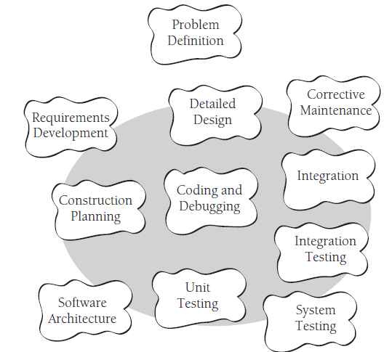
Software Construction & development process

Slide 11
Software Construction & development process (Cont.)
Problem Definition – First, clearly understand what problem needs to be solved.
Requirements Development – Then, gather and define what the software should do.
Software Architecture – Next, design the overall structure (the "blueprint") of the software.
Detailed Design – After that, design each small part in detail.
Construction Planning – Make a plan for coding (who will do what, tools, schedule).
Coding and Debugging – Write the actual code and fix errors.
Unit Testing – Test each small piece (unit/module) separately.
Integration – Combine all parts/modules together.
Integration Testing – Test whether the combined modules work together correctly.
System Testing – Test the entire system as a whole.
Corrective Maintenance – Finally, after release, fix errors and make improvements when users face issues.

Slide 12
SDC Specific tasks
Some of the specific tasks involved in construction are:
  Verifying that the groundwork has been laid so that construction can proceed successfully
  Determining how your code will be tested
  Designing and writing classes and routines
  Creating and naming variables and named constants
  Selecting control structures and organizing blocks of statements

Slide 13
SDC Specific tasks (Cont.)
Some of the specific tasks involved in construction are:
  Selecting control structures and organizing blocks of statements
  Unit testing, integration testing, and debugging your own code
  Reviewing other team members’ low-level designs and code and having them review yours
  Polishing code by carefully formatting and commenting it
  Integrating software components that were created separately
  Tuning code to make it faster and use fewer resources

Slide 14
SDC (Cont.)
Construction is also sometimes known as “coding” or “programming.” Do you think both these words correctly portray the term construction?

Slide 15
Importance of SDC
Software Construction is an important part of software development because
  Construction is a large part of software development
  Construction is the central activity in software development
  With a focus on construction, the individual programmer’s productivity can improve enormously
  Construction’s product, the source code, is often the only accurate description of the software
  Construction is the only activity that’s guaranteed to be done

Slide 16
SWEBOK Guide (2004 Edition)
According to the SWEBOK (Software Engineering Body of Knowledge) CH#3, the basic fundamentals of Software construction are
  Minimizing Complexity
  Anticipating Change
  Constructing for Verification
  Reuse
  Standards in Verification

Slide 17
Minimizing Complexity
Keep the software simple so it’s easier to understand, test, and maintain.
Example: Instead of writing one long method with 200 lines, break it into smaller methods like calculateTax(), applyDiscount(), and printBill().
This makes it easier for another programmer to follow.

Slide 18
Anticipating Change
Write code in a way that allows easy changes in the future.
Example: If you are building an e-commerce app, don’t hardcode the tax rate as 0.05. Instead, store it in a configuration file or database. If the tax changes, you won’t need to edit the code—just update the config.

Slide 19
Constructing for Verification
Write code that is simple to check.
Example: A function calculateInterest(amount, rate) should give the answer directly (e.g., 1000, 10% → 100) without using hidden values.

Slide 20
Reuse
Don’t reinvent the wheel—reuse existing code, libraries, or components.
Example: Instead of writing your own login system, use a ready-made authentication library like Spring Security in Java. This saves time and reduces bugs.

Slide 21
Standards in Verification
Follow coding and testing standards so that everyone works in the same way.
Example: Always write unit tests (using JUnit) before merging code, follow naming conventions, and use tools like Checkstyle or SonarQube to enforce standards. This ensures consistent quality.

Slide 22
Managing Construction
According SWEBOK guide, software construction is managed by following activities
Construction & Development Models → Use Agile model to build software in small iterations.
Construction & Development Planning → Plan coding tasks with Gantt chart for deadlines.
Construction & Development Management → Track progress using Jira to manage code quality and timelines.

Slide 23
Standards in Construction & development
Applying external or internal development standards during construction helps achieve a project’s objectives for efficiency, quality, and cost.
Choices of allowable programming language subsets and usage standards are important aids in achieving higher security.

Slide 24
Standards in Construction & development (Cont.)
Standards that directly affect construction issues include
  Communication methods (for example, standards for document formats and contents)
  Programming languages (for example, language standards for languages like Java and C++)
  Coding standards (for example, standards for naming conventions, layout, and indentation)
  Platforms (for example, interface standards for operating system calls)
  Tools (for example, diagrammatic standards for notations like UML (Unified Modeling Language)).

Slide 25
Key Points
Software construction is the central activity in software development; construction is the only activity that’s guaranteed to happen on every project.
The main activities in construction are detailed design, coding, debugging, integration, and developer testing (unit testing and integration testing).
Other common terms for construction are “coding” and “programming.”
The quality of the construction substantially affects the quality of the software.

Slide 26
Thanks
...?

